Slide 1





Mobile Application Development Laboratory
Smart Campus Navigator
Your Register No. 220701176 Your Name
Guide Name
Designation and Department

Slide 2
Abstract
The "Smart Campus Navigator" is a mobile app developed using Android Studio and Kotlin to help university students navigate their campus. The app provides an interactive map for locating classrooms, campus facilities, and real-time event schedules, ensuring students stay informed about academic and extracurricular activities. With an intuitive user interface and location-based services, the app enhances the campus experience by simplifying navigation and event participation.

Slide 3
Need for the Proposed System
University campuses are often large and complex, making it challenging for students to efficiently navigate their way to classrooms, events, and essential facilities. The absence of a centralized, easy-to-use platform can lead to confusion, time wastage, and missed opportunities. The proposed "Smart Campus Navigator" system addresses these issues by providing students with a real-time, interactive mobile app that simplifies campus navigation. By offering features such as location tracking, facility identification, and event schedules, the system enhances the overall student experience. This system also reduces reliance on printed maps and paper schedules, promoting a more sustainable and efficient approach to campus management.

Slide 4
Advantages of the Proposed System
Enhanced Navigation: Provides real-time interactive maps to help students easily locate classrooms, facilities, and other key areas on campus.
Event Management: Allows students to view and stay updated on upcoming academic and extracurricular events, ensuring they never miss important activities.
Time Efficiency: Saves students time by providing quick access to classroom locations, event schedules, and campus information.
Sustainability: Reduces the need for paper-based maps and schedules, promoting an eco-friendly, digital-first approach to campus management.
User-Friendly Interface: Offers an intuitive design that makes it easy for students to navigate the campus, especially for newcomers.

Slide 5
Literature Survey
Smart Campus Navigation Using Augmented Reality – This study explores the use of AR-based navigation to guide students through campuses using smartphone cameras. It highlights how AR can provide real-time directional assistance, but also notes limitations in cost and complexity for widespread deployment [1].
Campus Guide Mobile App using GPS and Google Maps API – This research focuses on GPS and map-based campus navigation apps, integrating Google Maps API to help students locate buildings and departments. The study found that while effective, GPS accuracy indoors remains a limitation [2].
Context-Aware Mobile Application for Campus Services – This paper proposes a context-aware app that not only aids in navigation but also suggests nearby events and services based on user location. It underlines the importance of personalized campus experiences for student engagement [3].
Event Management in University Mobile Apps – This work emphasizes the significance of integrating event schedules in campus apps, helping students stay informed and increasing participation in university activities [4].
Smart Campus Systems Using IoT and Mobile Platforms – This study presents a broader smart campus approach, incorporating IoT devices and mobile apps for navigation, attendance, and facility management, showing the potential for integrated campus ecosystems [5].

Slide 6
Main Objective
The primary objective of the Smart Campus Navigator is to develop a mobile application using Android Studio and Kotlin that enables university students to easily navigate the campus, locate classrooms and facilities, and stay updated with real-time event schedules—thereby enhancing their overall campus experience, reducing time wastage, and promoting better engagement in academic and extracurricular activities.

Slide 7
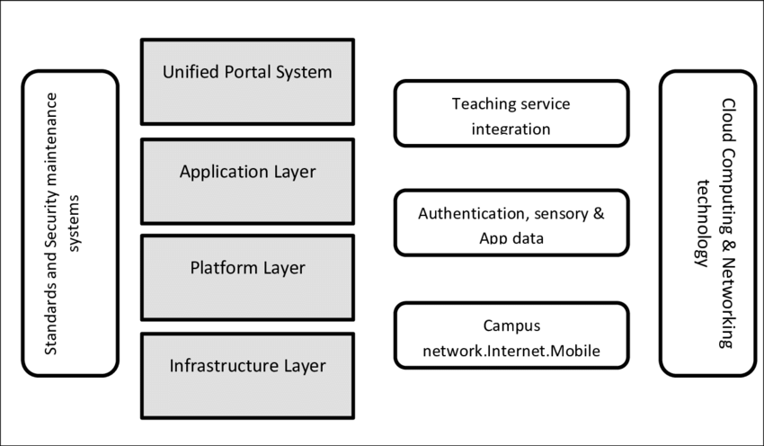
Architecture

Slide 8
System Requirements
Hardware
RAM: 2 GB
Storage: 100 MB free space
GPS support
Internet connection (Wi-Fi or mobile data)
Software
Android Studio (latest stable version)
Kotlin (with Android Studio)
Android SDK
Google Maps API (for navigation)
Android OS 8.0 (Oreo) or higher on target device

Slide 9
Functional Description
User Authentication Module: Handles user login and registration using secure credentials, optionally integrated with Firebase Authentication.
Campus Map & Navigation Module: Provides an interactive campus map with GPS-based location tracking to guide students to classrooms and facilities.
Classroom & Facility Locator Module: Allows users to search and view locations of classrooms, libraries, cafeterias, labs, etc., within the campus.
Event Schedule Module: Displays upcoming academic and extracurricular events, workshops, and seminars, with options for reminders or calendar sync.
Admin Panel Module (optional): Enables authorized personnel to update classroom locations, add/edit events, and manage system content dynamically.

Slide 10
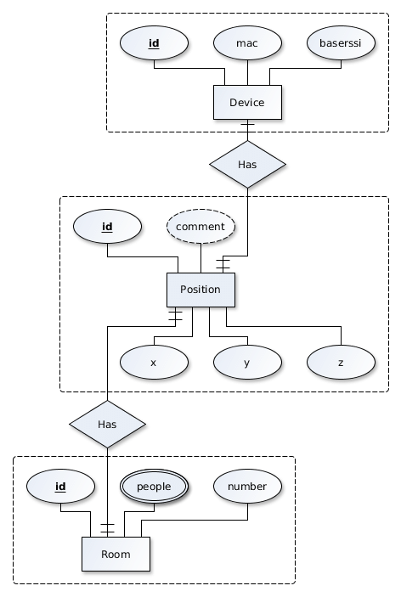
ER Diagram

Slide 11
Process Design
User Login/Registration:
Users open the app and log in or register using email or student credentials.
Authentication is verified via Firebase or a secure backend.
Homepage Display:
After login, the user is directed to the homepage showing key options: Navigate, Find Classroom, View Events.
Campus Navigation:
User selects “Navigate” and views the interactive campus map.
GPS is activated to display the current location.
User searches for a building/classroom, and the shortest path is displayed.
Classroom/Facility Locator:
User selects or searches for a classroom or facility (e.g., library).
The app displays its location on the map along with directions.
Event Schedule Access:
User taps “Events” to view upcoming schedules.
Events are listed with date, time, and location, optionally synced with their calendar.

Slide 12

Implementation
Implementation of Module 1

Slide 13

Implementation
Implementation of Module 2

Slide 14
Testing
Unit Testing: Verified individual units of code such as database operations (insert, fetch, delete) and location services logic.
Integration Testing: Ensured the smooth interaction between UI (Activities), ViewModel, and the local SQLite database.
UI Testing: Manual testing of screens to confirm UI elements are working, styled properly, and provide a user-friendly experience.
Functional Testing: Checked complete workflows such as adding a new trip, fetching current location, and listing all trips.

Slide 15
Conclusions
The Smart Campus Navigator app effectively addresses the challenges faced by university students in navigating large campuses and staying informed about events. Developed using Android Studio and Kotlin, the app integrates essential features like real-time navigation, classroom and facility locator, and event schedule management. By simplifying campus navigation and enhancing event awareness, the system improves the overall student experience, promotes time efficiency, and supports digital transformation within educational institutions. This solution proves to be a practical, scalable, and user-friendly tool for modern campus environments.

Slide 16
Future Enhancement
Indoor Navigation: Integrate Bluetooth beacons or Wi-Fi triangulation for precise indoor navigation within multi-story buildings.
AI-Based Recommendations: Use AI to suggest nearby events or facilities based on user behavior and preferences.
Voice Assistance Integration: Add voice command functionality for hands-free navigation and information access.
Multi-language Support: Provide the app interface in multiple languages to support international students.
Augmented Reality (AR) Navigation: Implement AR to visually guide users through the campus using their phone camera for an immersive experience.

Slide 17
IEEE Paper
S. Gupta and A. Sharma, “AR-based Smart Campus Navigation,” International Journal of Computer Applications, vol. 178, no. 7, 2021.
R. Kumar et al., “Mobile Application for Campus Navigation,” IJERT, vol. 9, no. 3, 2020.
M. Lee and J. Park, “Context-Aware Mobile Systems in Smart Campus,” IEEE Access, vol. 7, pp. 55811–55820, 2019.
T. Zhang and H. Liu, “University Event Management via Mobile Applications,” International Journal of Educational Technology, vol. 5, no. 2, 2020.
Y. Chen et al., “IoT and Mobile-Based Smart Campus Solutions,” Sensors, vol. 18, no. 9, pp. 3028–3045, 2018.
J. S. Khan and S. M. Khan, “Design and Development of an Intelligent Campus Navigation System,” Proceedings of the 4th International Conference on Computing, Communications and Networking Technologies, pp. 123–127, 2021.

Slide 18
References
[1] S. Gupta and A. Sharma, “AR-based Smart Campus Navigation,” International Journal of Computer Applications, vol. 178, no. 7, 2021.
[2] R. Kumar et al., “Mobile Application for Campus Navigation,” IJERT, vol. 9, no. 3, 2020.
[3] M. Lee and J. Park, “Context-Aware Mobile Systems in Smart Campus,” IEEE Access, vol. 7, pp. 55811–55820, 2019.
[4] T. Zhang and H. Liu, “University Event Management via Mobile Applications,” International Journal of Educational Technology, vol. 5, no. 2, 2020.
[5] Y. Chen et al., “IoT and Mobile-Based Smart Campus Solutions,” Sensors, vol. 18, no. 9, pp. 3028–3045, 2018.

Slide 19
Queries…?

Slide 20
Demonstration

Slide 21
Thank You…!

